Slide 1
Programming fundamentals
Section 3

Slide 2
Setw()
Library: #include <iomanip>
#include<iostream> #include <iomanip> using namespace std; void main() { int PhysicsGrade=70, MathGrade=90, ProgrammingGrade=100, Englishgrade=85; cout << setw(20) << "Subject" << setw(20) << "Grade"<<"\n"; cout << setw(20) << "Physics" << setw(20) << PhysicsGrade << "\n"; cout << setw(20) << "Math" << setw(20) << MathGrade << "\n"; cout << setw(20) << "Programming" << setw(20) << ProgrammingGrade << "\n"; cout << setw(20) << "English" << setw(20) << Englishgrade << "\n"; system("Pause");}

Slide 3
The sizeof operator can be used to determine to the number of bytes occupied in memory by a variable of a certain type.
#include<iostream> using namespace std; void main() { cout << "sizof(integer)is:" << sizeof(int) << "byte" << endl; cout << "sizof(float)is:" << sizeof(float) << "byte" << endl; cout << "sizof(character)is:" << sizeof(char) << "byte" << endl; system("Pause"); }

Slide 4
Bool Data Type
Two values: true and false ( one or zero )
#include <iostream> #include<string> using namespace std; void main() { int x1 = 10, x2 = 20; bool b1, b2; b1 = x1 == x2; b2 = x1 < x2; cout << "b1 = " << b1 << "\n"; cout << "b2 = " << b2 << "\n"; system("Pause"); }

Slide 5
String Data Type
To use the string type, you need to access its definition from the header file string
Include the following preprocessor directive:
#include <string>

Slide 6
String Data Type
#include <iostream> #include<string> using namespace std; void main() { string str; cout << "Enter a string: "; getline(cin, str); cout <<"You entered:" << str <<endl; system("Pause"); }

Slide 7
Get string length
Length of a string is number of characters in it
#include <iostream> #include<string> using namespace std; void main() { string str ="This is a c++ Program"; cout << "The length of the string = " << str.length()<<endl; system("Pause"); }

Slide 8
Write a program
Convert a given number of seconds to hours, minutes and seconds then print them in the format: 5:17:9.
int seconds, minutes, hours; cout << "Enter Seconds number "; cin >> seconds; hours = seconds / 3600; minutes = seconds % 3600 / 60; seconds = seconds % 3600 % 60; cout << hours << ":" << minutes << ":" << seconds << endl;

Slide 9
Operators
There are four main classes of operators:
- Arithmetic
- Relational
- Logical
- Bitwise.

Slide 10
Arithmetic Operators
Operator | Action
− | Subtraction, also unary minus
+ | Addition
* | Multiplication
/ | Division
% | Modulus
– – | Decrement
++ | Increment

Slide 11
Increment and Decrement
The operator ++ adds 1 to its operand, and - - subtracts 1.
Both the increment and decrement operators may either prefix or postfix the operand.
x=x+1 x++ or ++x
x=x-1 x-- or --x
When an increment or decrement operator precedes its operand, the increment or decrement operation is performed before obtaining the value of the operand for use in the expression. If the operator follows its operand, the value of the operand is obtained before incrementing or decrementing it

Slide 12
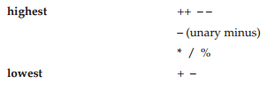
Increment and Decrement
x = 10; y = ++x; | x = 10; y = x++; | x=10; y=--x; | x=10; y=x--;
sets y to 11 | sets y to 10 | Set y to 9 | Set y to 10;
The precedence of the arithmetic operators:

Slide 13
Example
#include<iostream> using namespace std; void main() { int x = 5; int y = 10; int z = ++x * y-- + 10; cout << z<<endl; system("Pause"); } | #include<iostream> using namespace std; void main() { int x = 5; int y = 10; int z = ++x * --y+ 10; cout << z<<endl; system("Pause"); }

Slide 14
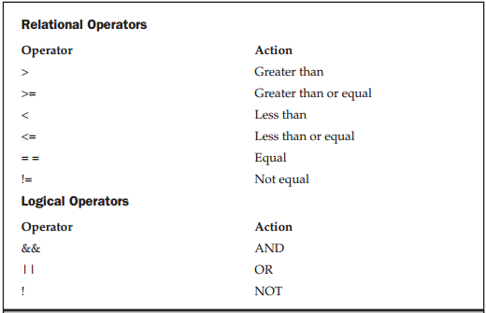
Relational and Logical Operators
Expressions that use relational or logical operators return 0 for false and 1 for true.

Slide 15
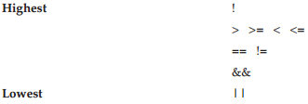
Relational and Logical Operators
Both the relational and logical operators are lower in precedence than the arithmetic operators.
the relative precedence of the relational and logical operators:
Example
10>5 && !(10<9) || 3<=4 True

Slide 16
One's complement (NOT)
Example
Original byte 0 0 1 0 1 1 0 0 After 1st complement 1 1 0 1 0 0 1 1 After 2nd complement 0 0 1 0 1 1 0 0 After Two’s Complement 1 1 0 1 0 1 0 0

Slide 17
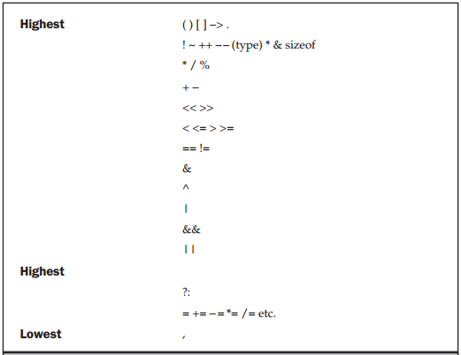

Slide 18
Show Output
#include<iostream> using namespace std; void main() { int x = 4; int y = 3; cout<< y++ * x-- <<endl; cout<< ++y * x-- << endl; cout<< ++y * --x << endl; system("Pause"); }

